Slide 1
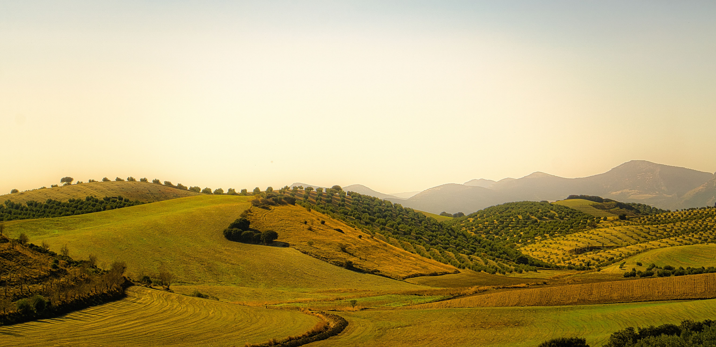
RootCause
End-to-End Agricultural Resilience
Spring Planting & Summer Drought Intelligence Across CA, DE, IA, and NE
Presented By:
Amari Majette, Brianna Snell, Habibah Kashmiri, Hafsah Kashmiri, Ebonee Kent

Slide 2
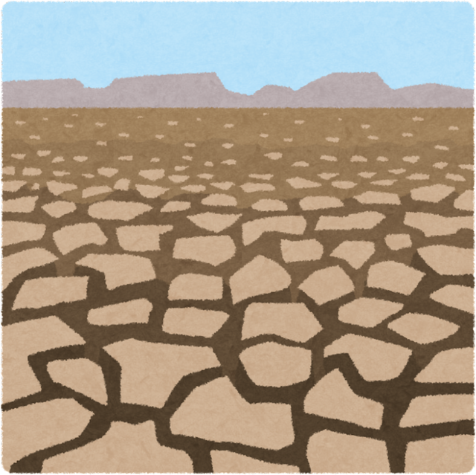
The Problem
Summer Drought
Drought affects counties differently depending on weather and soil conditions.
The Challenge: Making informed decisions before crop damage occurs.

Slide 3


Tailored Intelligence for Agricultural Decision-Makers
Extension Agronomist:
Spring Window
NRCS Regional Officer:
Summer Window
March | April | May | June | July | August
Initial Frost Risks | Servere Frost Events | Lingering Frost Risks | Transition Period | High Drought Defence | Critical Water Need

Slide 4
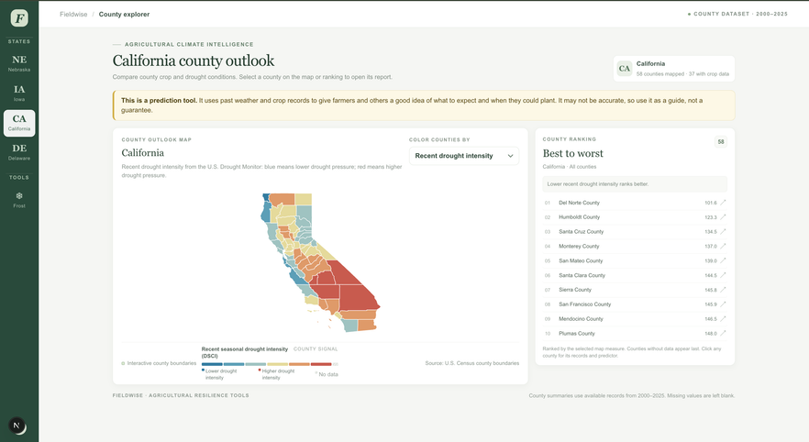
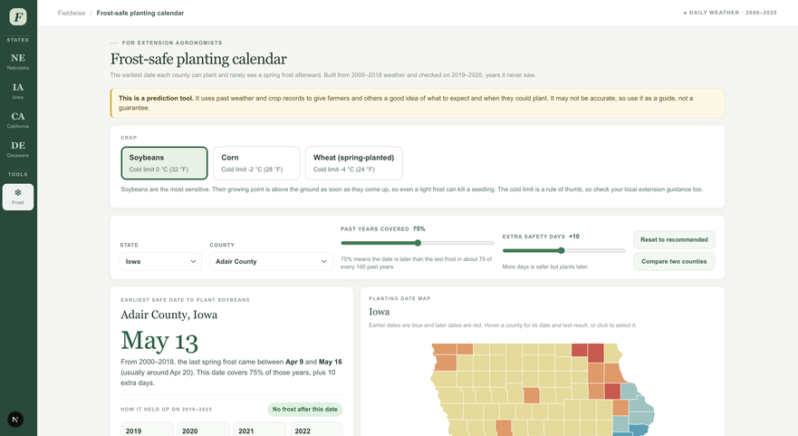
Our Solution
County Explorer:
Spring Frost Calendar:
Drought maps, soil conditions, and crop-yield trends.
Planting guidance based on historical frost data.

Slide 5

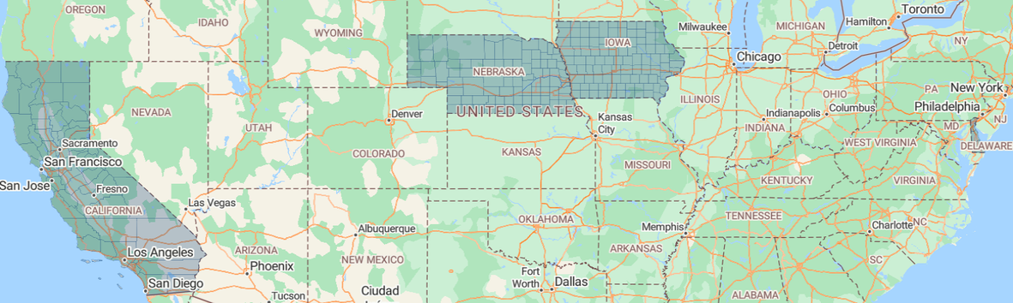

Data, Validation & Limitations
Trained on historical weather and agricultural records covering 2000–2025 across all 4 states.
Frost Calendar Validation
Transparency and Limitations

Slide 6


Impact & Conclusion
Spring: More informed planting guidance.
Summer: Better drought-risk awareness.
Our Mission: Supporting agricultural professionals and the farmers they serve.

Slide 7
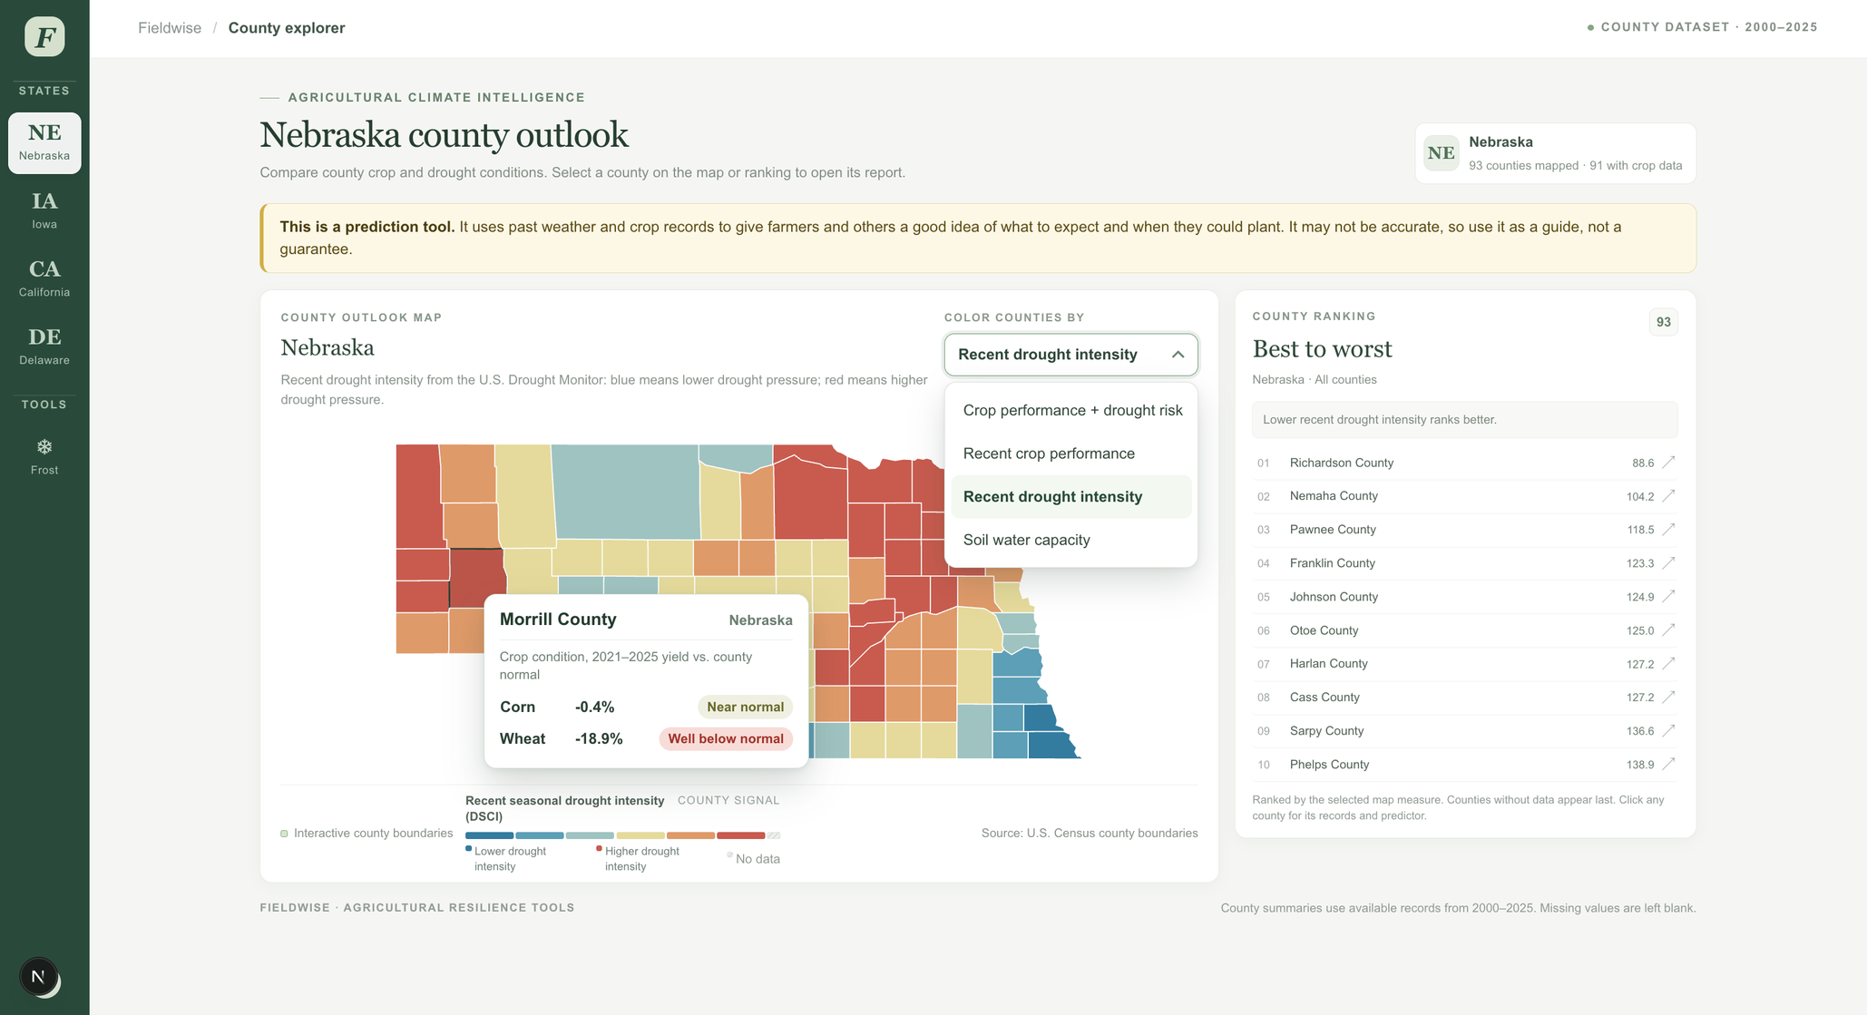
Live- Demo

Slide 8
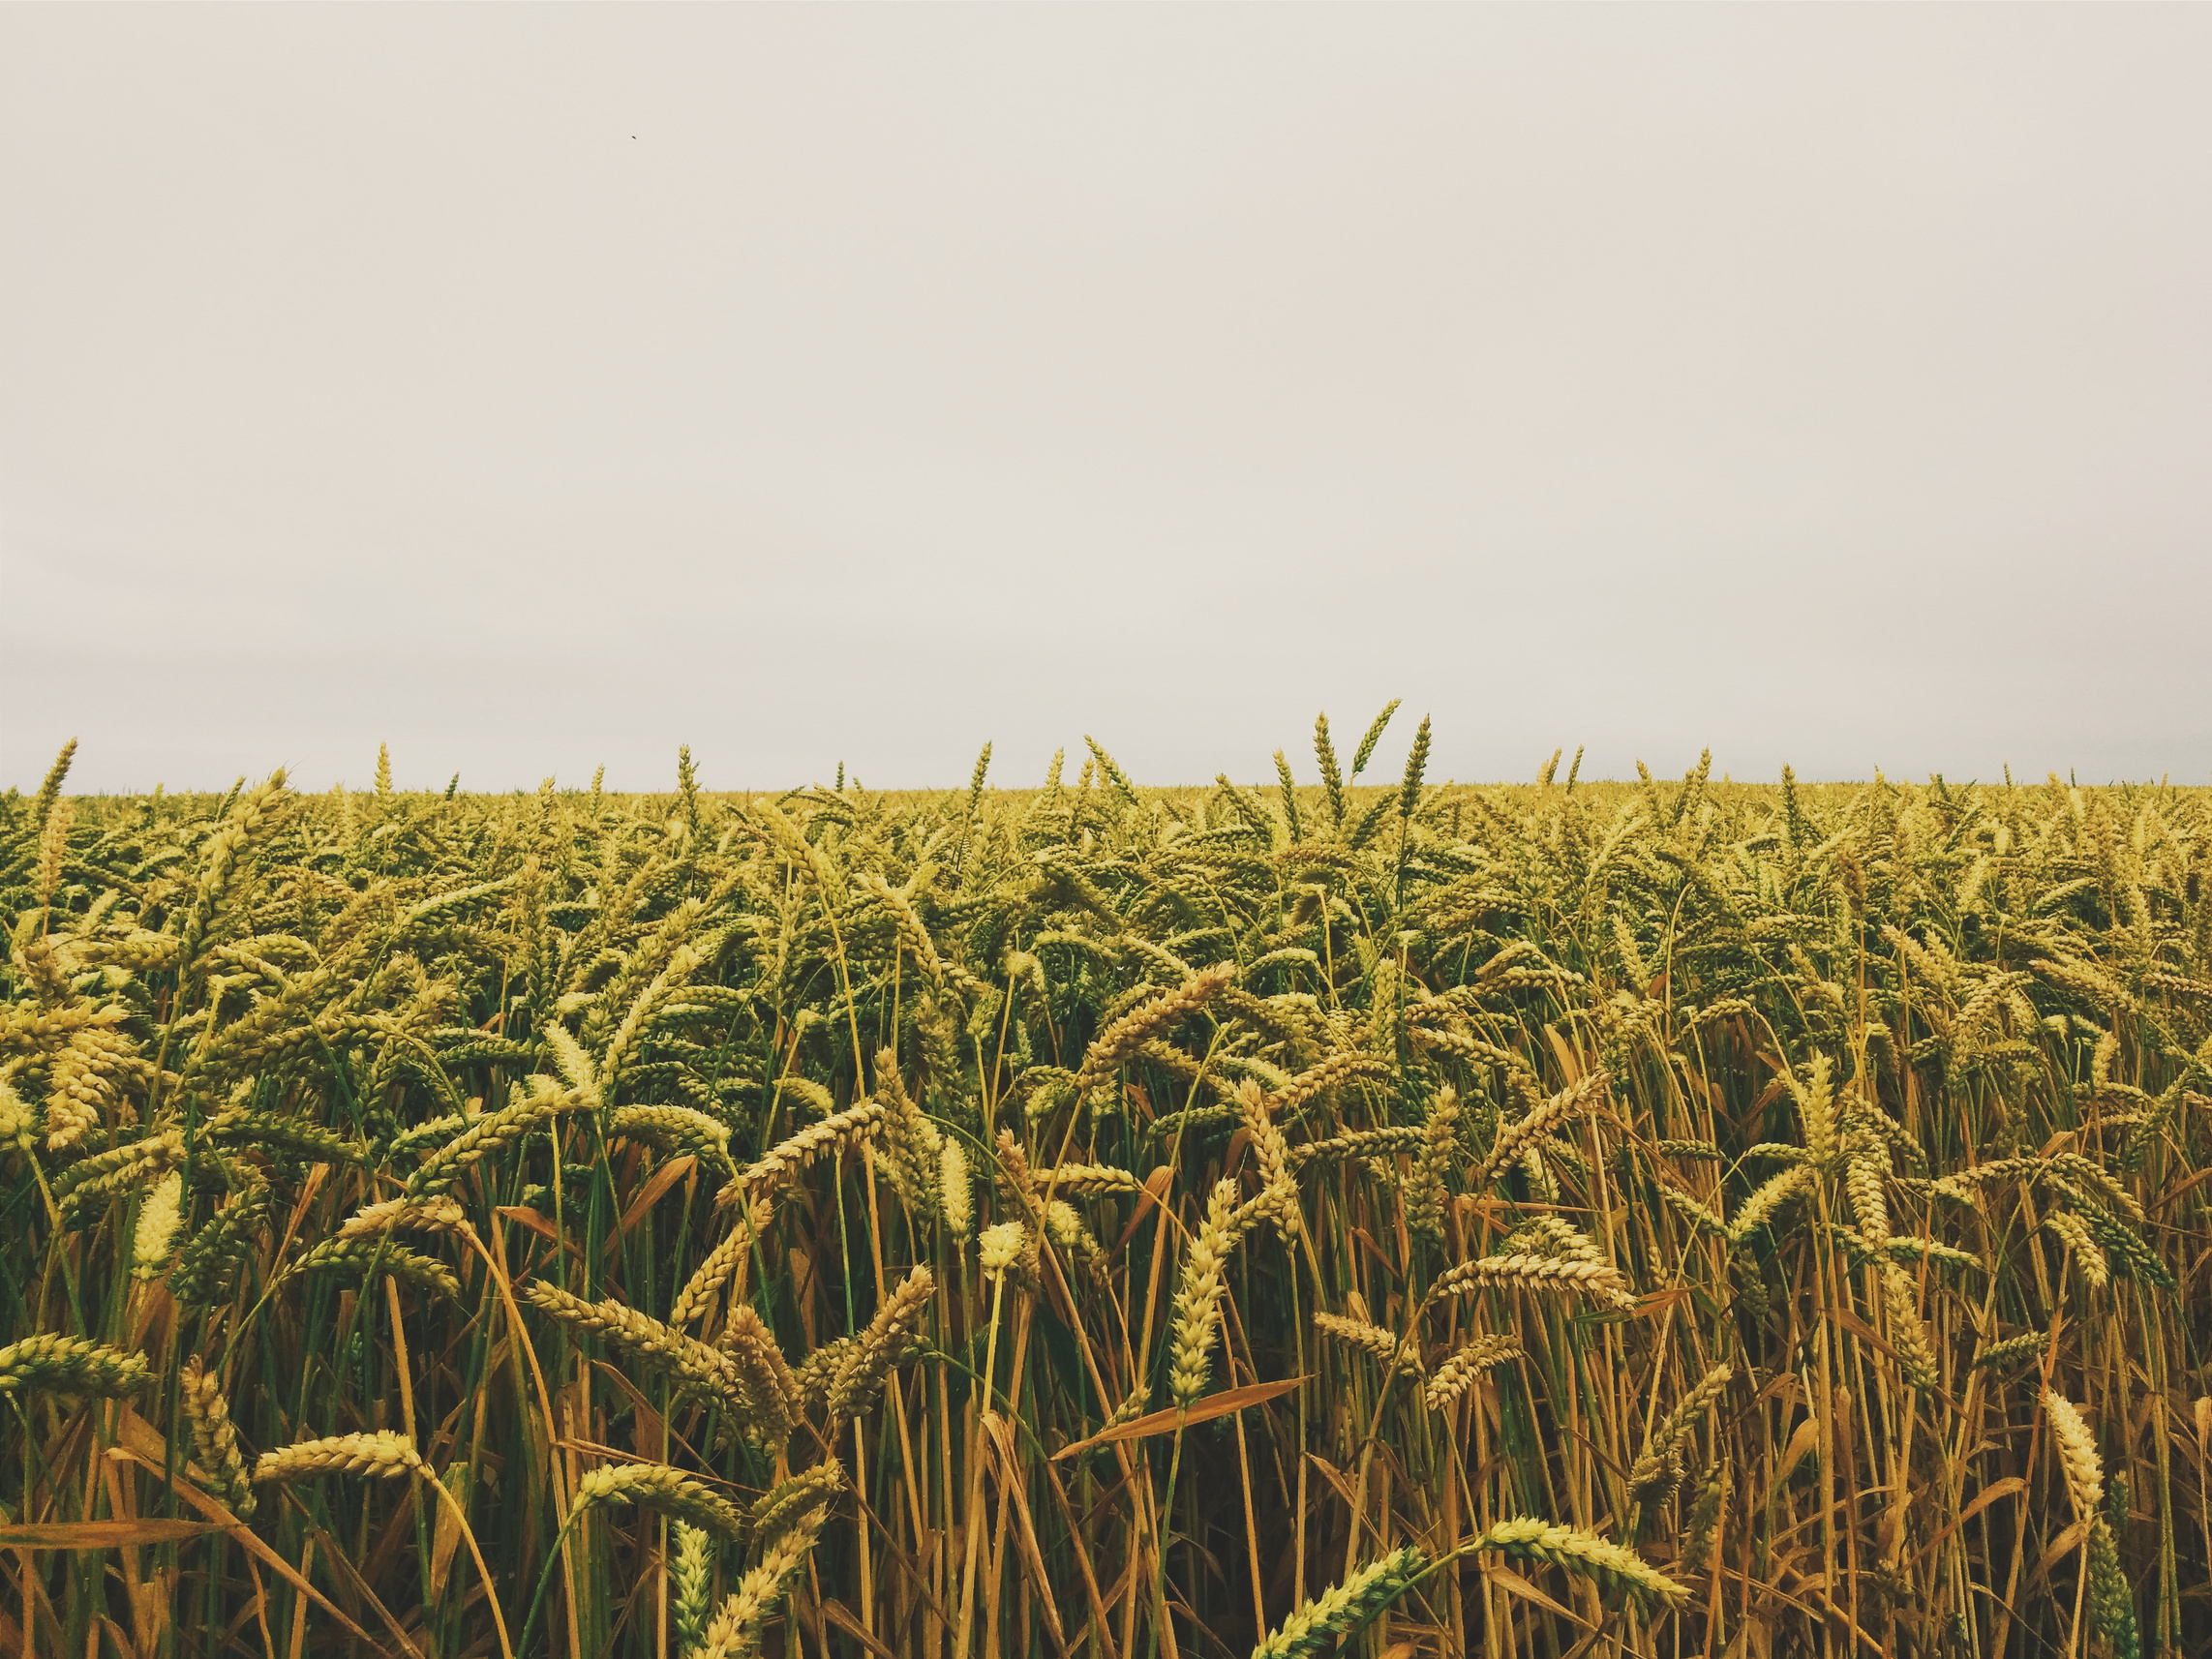
RootCause
MS-CC Hackathon 2026
Thank You
QUESTIONS?

